Slide 1
HL ONLY
TOPIC B4:
ABSTRACT DATA TYPES
LESSON B4-1
ABSTRACT DATA TYPES AND LISTS

Slide 2

AGENDA
ADTs
Linked Lists
Nodes
Pointers
Advantages
Disadvantages
Singly Linked Lists
Doubly Linked Lists
Circular Linked Lists
Traversal/Search
Insertion
Deletion
WHAT U NEED 4 LESSON
Pycharm
Notes Document

Slide 3

THE WARM UP QUESTION
Identify three properties of Python lists

Slide 4
THE WARM UP ANSWER
Variable length
Can store multiple data types
Can store multiple objects
Can be inserted into at any point
Can be appended to
Can have items removed from it

Slide 5
ADTS
Abstract Data Types are fundamental constructs in programming that provide a framework for data manipulation
Users interact with ADTs without needing to understand the underlying implementation details
This is an example of what?
ABSTRACTION!!!!

Slide 6

ADTS
Encapsulation is also integral to ADTs, as it helps us safeguard the data’s integrity by restricting access to the data structure

Slide 7
ADTS
An abstract data type is accessed only by its functions, preventing unauthorized access or harmful modifications to the data structure
This improves the reliability of the ADT

Slide 8



ADTS
When we define an abstract data type, it isn’t about how it’s implemented
It’s about what it can do
This means that you can implement an ADT in any number of different programming languages, and it should act the same
Reduce development time by increasing reusability of logic

Slide 9

ADTS
ADTs also employ modularity
We split a complex problem into smaller, manageable components (or modules)
This makes it easier to debug and test

Slide 10
ADTS
Through this abstraction, are there risks to simplifying things too much?
What’s an instance where this could occur?

Slide 11
LINKED LISTS
An ADT that we should already be familiar with are lists
Or, as we perhaps should say, the Linked List
Linked lists contain two main elements:
Pointers and Nodes

Slide 12

NODES
Nodes are the element in a list that holds the data
Nodes are (typically) OBJECTS
There are two types of very important nodes:
The head node:
The start of the list
The tail node:
The ending of the list
These two nodes help us to navigate the list

Slide 13
POINTERS
Pointers are contained within the node
Pointers point to the next node in the list
Sometimes, we also have pointers that point to the previous node in the list
Pointers are sometimes called references, because it references the memory address where the next node resides

Slide 14

POINTERS
Some people like to think of this like a chain of elephants for some reason
The trunks and tails connect like pointers connect one node to another in a linked list

Slide 15

ADVANTAGES OF LINKED LISTS
Let’s quickly look at three different advantages of linked lists

Slide 16
ADVANTAGES OF LINKED LISTS
Dynamic Data Structures:
Lists are able to grow and shrink in size as we add and remove nodes
We don’t have these in Python, but Java’s default list equivalent is called an Array
Arrays require you to tell it how many items will go into it ahead of time, and it reserves that much space
If a linked list is a line of elephants, think of an array as a pre-made shelf with slots for data

Slide 17
ADVANTAGES OF LINKED LISTS
Memory Utilization
Lists can be more efficient with memory usage, as they don’t reserve space like an array does
If you don’t fill an array fully, the space is still taken up

Slide 18
ADVANTAGES OF LINKED LISTS
Efficient insertion and deletion:
Linked lists are able to insert items into the middle without needing to shuffle other items around like an Array

Slide 19
DISADVANTAGES OF LINKED LISTS
Now, let’s look at some disadvantages of linked lists

Slide 20
DISADVANTAGES OF LINKED LISTS
Sequential Access
You can’t access lists via index. Y’know, the whole list[3] thing
The only reason Python’s does is because they added that feature as extra, but it isn’t standard
Normally, you need to start at the head node, and follow the pointers until you find what you’re looking for
Which of the 4 algorithms that we are required to know looks like this?
Which of the 4 algorithms won’t work with a standard linked list because of this?

Slide 21
DISADVANTAGES OF LINKED LISTS
Memory utilization
Each node requires a reference/pointer to the next, which is extra data to store
If your list expands to the point where you have more in it than you have memory available, you’ll run out of heap space

Slide 22
TYPES OF LINKED LISTS
Singly linked list
Simplest of the three, with each node containing a single pointer to the next node in the list, with the tail node containing a pointer to none or null
NODE
A
B
C
HEAD
NULL/NONE
DATA
POINTER

Slide 23
TYPES OF LINKED LISTS
Doubly linked list
Nodes have two pointers, one reference to the next node, and one to the previous node
This lets us travel forward and backwards in the list
NODE
NEXT POINTER
 | A
 | B
 | C
NULL/NONE
HEAD
NULL/NONE
DATA
PREVIOUS POINTER

Slide 24

TYPES OF LINKED LISTS
Circular linked list
Similar to singly linked lists, but the tail node points back to the head node
This lets you continuously, circularly traverse the list (you can also do this for a doubly linked list)
A
A
A
HEAD

Slide 25

TYPES OF LINKED LISTS
Circular linked list
Similar to singly linked lists, but the tail node points back to the head node
This lets you continuously, circularly traverse the list (you can also do this for a doubly linked list)
A
A
A
HEAD

Slide 26
LINKED LIST TRAVERSAL
The steps for this are basically just a linear search
You start at the head of the linked list, and follow the pointers through the nodes
Step 1: Start with the head pointer to find the first node in the linked list
Step 2: From this node, follow the pointer within the node to the next node
Step 3: Repeat step 2 until you find the node you’re searching for, or until the pointer points to null/none, meaning you’ve reached the end of the list

Slide 27
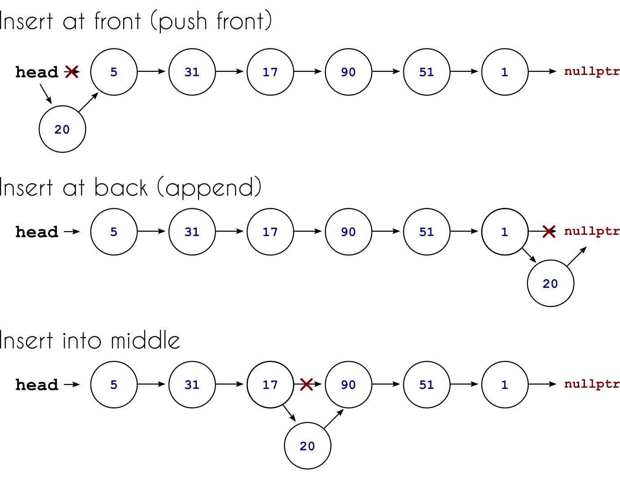
LINKED LIST INSERTION
Unfortunately for us, inserting into a linked list takes a bit more effort
There are 3 kinds of linked list insertions:
The start, the middle, and the end

Slide 28
LINKED LIST INSERTION
Inserting at the start of the list
1: Create a new node
2: Point the new node to the current head node
3: Update the head pointer of the linked list to the new node

Slide 29
LINKED LIST INSERTION
Inserting at the end of the list
1: Create a new node
2: Find the last node by traversing the list until you find the tail node that points to null
3: Point the current tail node to the new node (the new node’s pointer will automatically be null)

Slide 30
LINKED LIST INSERTION
Inserting in the middle of a list:
1: Create a new node
2: Traverse the list to find the node after which you want to insert the new node
3: Set the new node’s pointer to point to the newly found node’s pointer
4: Set the newly found node’s pointer to the new node

Slide 31
LINKED LIST DELETION
Deleting a node also has three methods for beginning, middle, and end of a linked list

Slide 32
LINKED LIST DELETION
Deleting the first node:
1: Check whether the list is empty (if the head poiner is already null, the list is empty)
2: Set the head pointer to the new first node’s pointer
Now nothing is pointing to the original first node, eliminating it from the list

Slide 33
LINKED LIST DELETION
Deleting a middle node:
1: Traverse the list, starting from the head, to find the node you want to delete
While doing this, keep a pointer referencing the previous node, we’ll need it
2: If you find the node to delete, use the previously visited node’s pointer and adjust it to point to the found node’s pointer
Now, nothing is pointing to the found node, and it’s no longer in the list

Slide 34
LINKED LIST DELETION
Deleting the end node:
1: Traverse the list, starting from the head, until you find the tail node pointing to null
While doing this, keep a manual pointer to the previous node
2: Adjust the previously visited node’s pointer to null

Slide 35
LABBB
Create a singly linked list with the names: Aaron, Yan, Sophie, Jane, and Ellen
Draw the steps to do the following:
Insert Noah after Sophie
Delete Ellen
Add Lane at the head

Slide 36

VOCABULARY TO REMEMBER
Linked List
Singly Linked List
Doubly Linked List
Circular Linked List
Head
Pointer
Node

